Slide 1
Systemic Knowledge: What is it?
We all live in an exciting time when modern science can no longer conceal the ignorance hidden behind it.

Slide 2
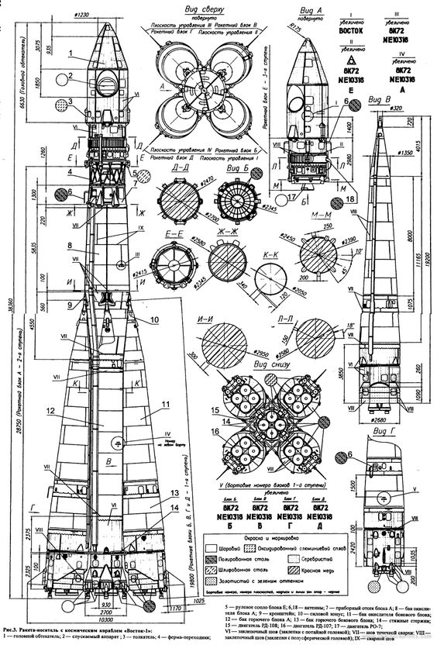
Ignorance - some might be surprised-
what ignorance is there to discuss if
the whole world is “packed” with information about discoveries, phenomena, hypotheses, theories, and their practical implementations?

Slide 3
Let us clearly define what information and knowledge are.

Slide 4
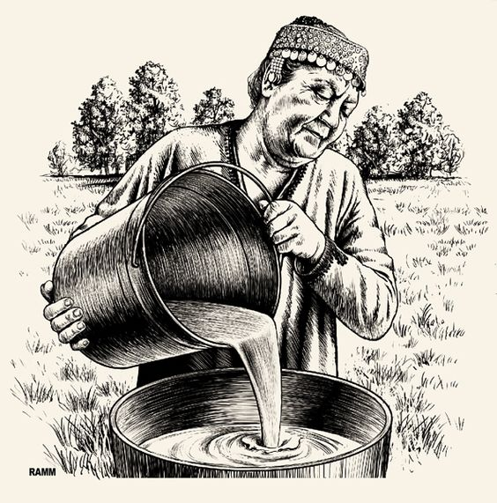
Some may immediately object:
Aren’t these two the same thing?
The similarity of these concepts can be misleading, but if we pause for a moment and reflect on the meaning of these two words, our reaction would be no less than pure astonishment.

Slide 5
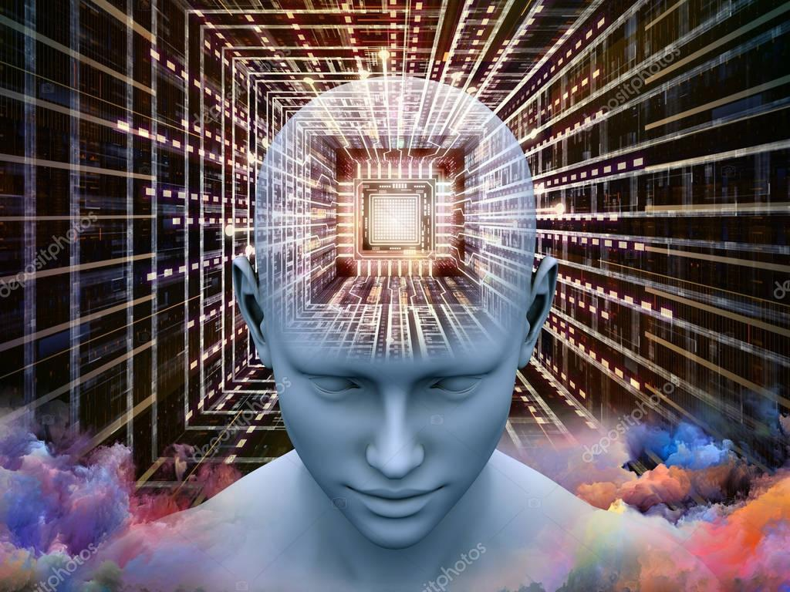
Each word has its own meaning, not
just its own sound. Let us more closely examine the meaning of the words – “information” and “knowledge”

Slide 6
Information is a message we receive through the sensory organs about what
is happening around and within us.

Slide 7
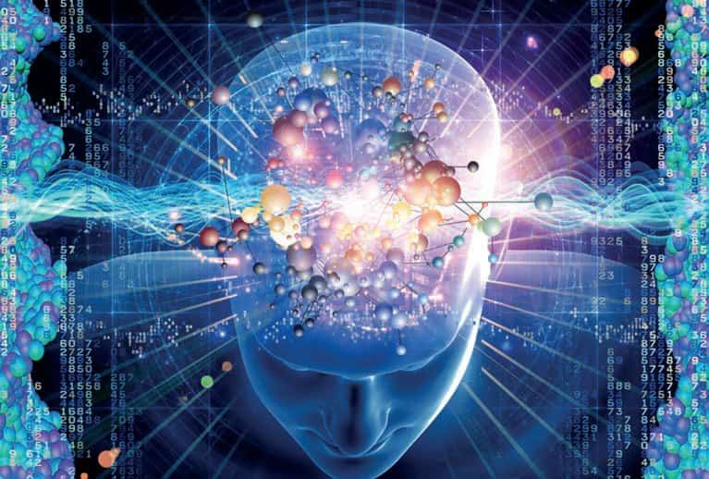
Knowledge is comprehending and understanding what is happening around and within us.
At first glance, it may seem like a minor difference, but in reality, these concepts differ like day and night.

Slide 8
Knowledge is meaningful and the understanding of cognized information received through our sensory organs about what is happening around and within us.
Modern earthly civilization has undoubtedly accumulated enormous volumes of terabytes of information. Unfortunately, there has been little comprehension and understanding of this information.

Slide 9
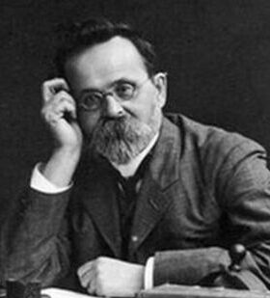
Nikolai Aleksandrovich Morozov
However, this information began to be studied over one hundred years ago by a Russian political prisoner, a physics, chemistry, astronomy, and history academic: Nikolai Aleksandrovich Morozov. He was the author of a significant and unique seven-volume work called "Christ."
Morozov laid the groundwork for revising traditional history. He presented biblical texts as a reflection of real astronomical observations of early medieval Christian astronomers and formulated the theory of the total falsification of human history.
"The ancient world with its scientific worldview and especially the history
of the first centuries of Christianity, are now separated from us as if by an impenetrable veil of dark church autocracy, which in the XII-XV centuries, filtered through its fire all historical documents and allowed us only those of that were favorable to the ruling church, and then often in a half-forged form, or distorted beyond recognition."

Slide 10
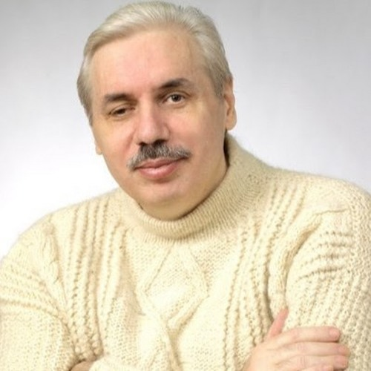
Nicolai Viktorovich Levashov
He created the System of Knowledge, the only postulate of which is the position that matter is an objective reality given to us in sensations. In his fundamental works and speeches, Nicolai Viktorovich provided answers to many questions that stir the thoughts of humanity:
- what is our universe
- what is life
- is there life after death
- how does our brain work
- what is memory
- what are consciousness and subconsciousness
- what is love and much more...

Slide 11
Alexander Mikhailovich Khatybov
“Everything we studied turned out to be made of Legos and horse grammar.”
Most of A. M. Khatybov's works are devoted to carrying out calculations for many fundamental scientific directions of the future. He carried out all the necessary calculations and put them into practice.
The unique mathematics he developed helped him recreate Earth's future natural state and describe the physics of processes occurring in a human living cell, such as the physics of Energies and the physics of the Brain, with a complete understanding of what the Brain is.
Our descendants are the only ones who will be able to comprehend the significance of what has been accomplished. As of today, the results of his work are still classified.

Slide 12
Boris Viktorovich Makov
He pursued scientific research and applied activities aimed at a single goal: to bring the level of knowledge as close as possible to the truth about the "Created World" and, based on this, to offer practical solutions to the current and future generations of people for transitioning to a different path of civilizational development.

Slide 13
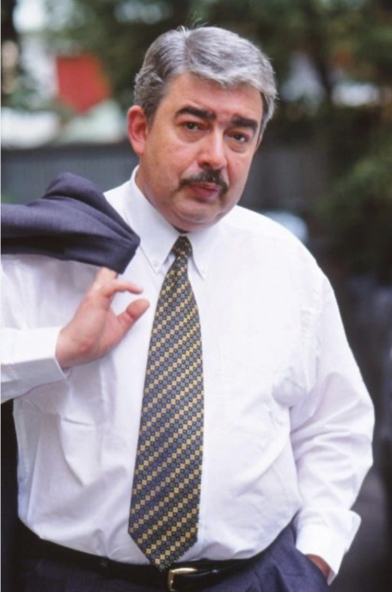
Feodor Dmitrievich Shkrudnev
Together with Nicolai Levashov and Boris Makov, he continued fundamental developments related to Levashov’s life work.
Feоdor Shkrudnev wrote:
“All scientific” explanations quickly become one of many postulates (an assertion taken without proof) and explain nothing at the level of understanding the process.
Yes, we have learned to use some fragments without understanding the essence, but this has quickly put us on the brink of extinction, and we cannot prove our high level of knowledge. We are practically powerless and defenseless against nature because we do not know the essence of the phenomena that occur within it, and, of course, we cannot utilize these phenomena. All of this is a consequence of the false knowledge base which we acquire in adapting to adult life.

Slide 14
Therefore, our first task is to assimilate new knowledge based on the alphabet and grammar embedded in this knowledge platform, which will become your new foundation. Without changing the foundation, no matter how hard we try, we will “intelligently” move in a different direction; we cannot understand the essence of phenomena without proper foundational knowledge, without an actual alphabet and grammar.
“Only by changing the foundation - carefully studying and understanding the relevant books - can we acquire and understand NEW KNOWLEDGE and its practical application.”
Feodor Shkrudnev

Slide 15
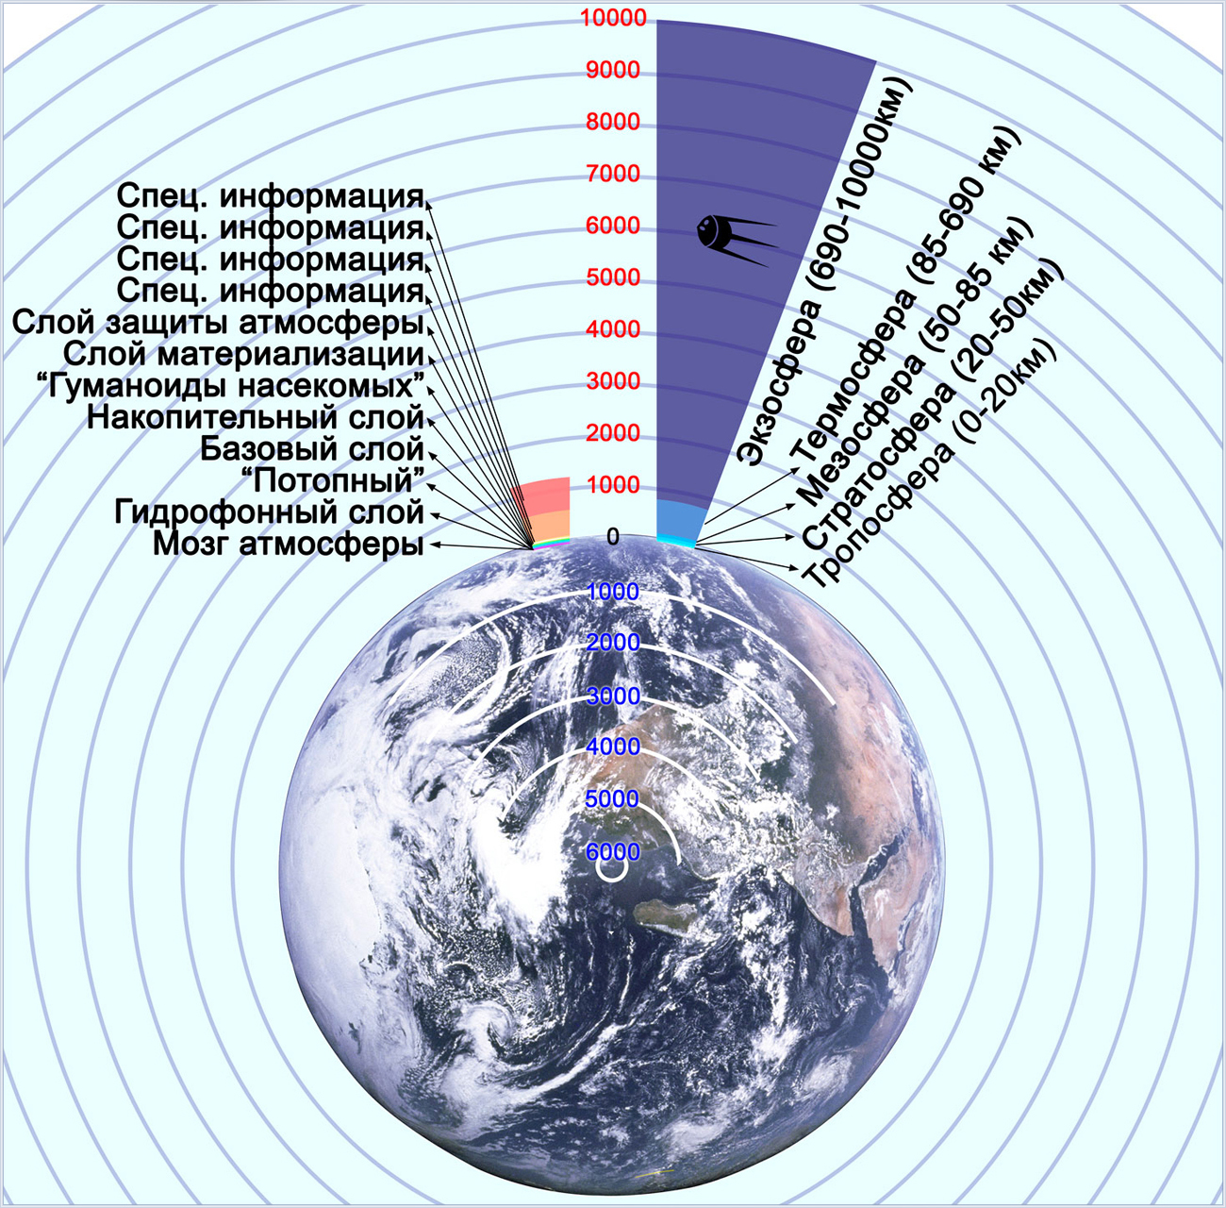
An unscientific approach
differences
Modern Science
Atmosphere
Restricted Information
Atmospheric protection layer
Materialization layer
Insect humanoids storage layer
Base layer
Flood Hydrophanous layer
Atmospheric brain
Exosphere (690-10000km)
Thermosphere (85-690km)
Mesosphere (50-85km)
Stratosphere (20-50km)
Troposphere (0-20km)
Generated by a
randomly formed
gas mixture
Strictly organized grid series structure
The Basis –
Systemic Knowledge
The basis – modern science based on horse power

Slide 16
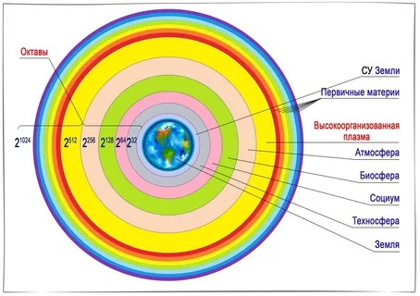
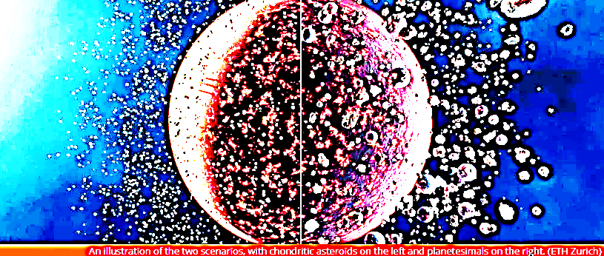
An unscientific approach
differences
Modern Science
Earth
The frequency
Exists due to the Control System (CS) located inside the planet at a certain depth
Earth’s CS
Primary Matter
Highly Organized Plasma
Formed out of dust
Atmosphere
Biosphere
Society
Technosphere
Earth
The Basis –
Systemic Knowledge
The basis – modern science based on horse power

Slide 17
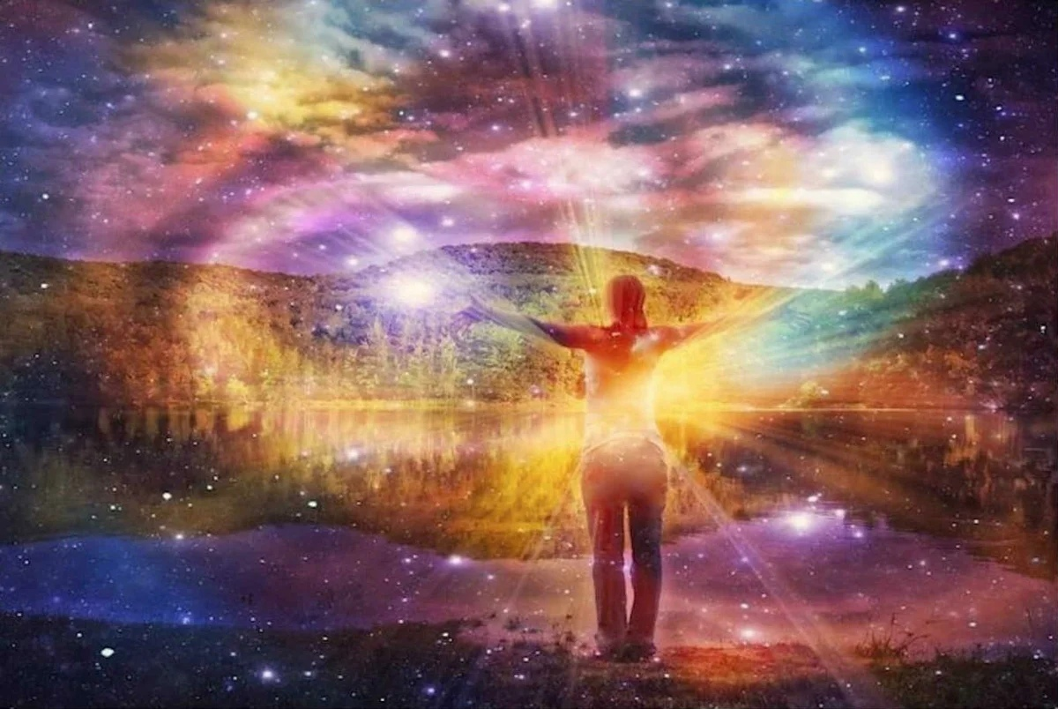
An unscientific approach
Modern Science
differences
Fields
There are 3 fields as physical structures; they can be conditionally called electric, magnetic, & gravitational; they differ in their frequency and charge properties (in DI structures there are 4 to 512 charge octaves, and in k-structures there are 16 to 128 octaves)
The number of designations is unlimited, from kibbutz to astral
The Basis –
Systemic Knowledge
The basis – modern science based on horse power

Slide 18
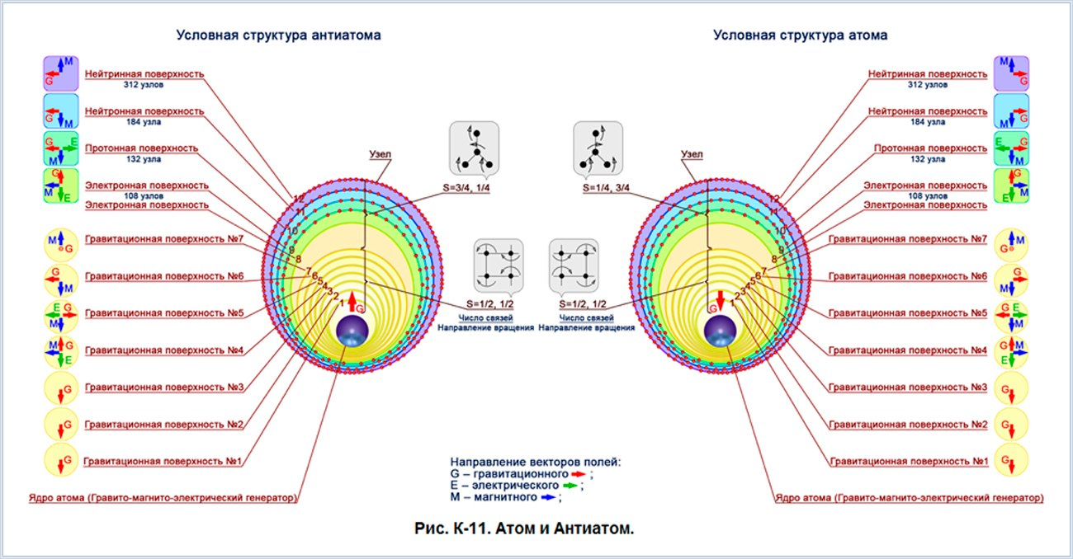
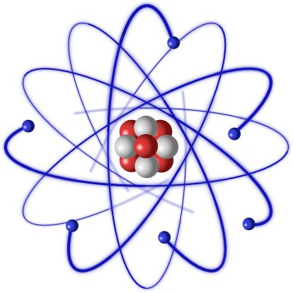
An unscientific approach
Modern Science
differences
Matter
The contingent structure of the atom
The entire world, both on Earth and in the Cosmos, is made up of Bohr atoms
If the charge of the octave is less than 66, a rigid proton atom (matter) structure is formed
The Basis –
Systemic Knowledge
The basis – modern science based on horse power

Slide 19
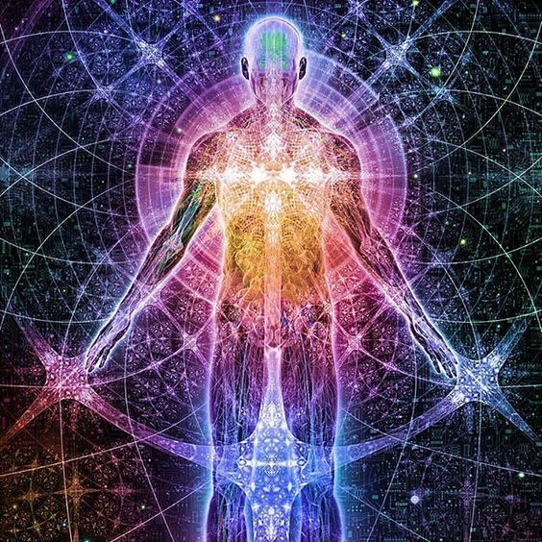
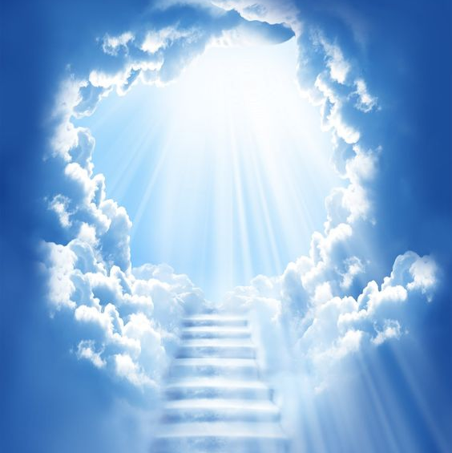
An unscientific approach
Modern Science
differences
The Spirit
If the charge of the octave is greater than 64 (up to 512) a non-inertial mass quantized by purpose and properties is generated
The spirit, usually holy, exists apart from matter
The Basis –
Systemic Knowledge
The basis – modern science based on horse power

Slide 20
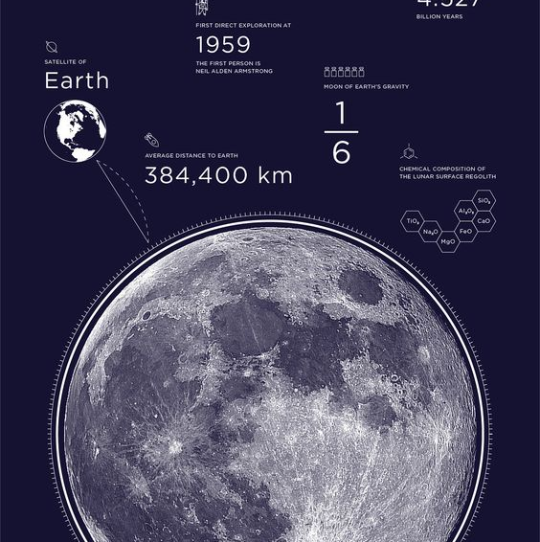
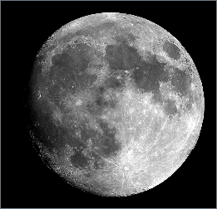
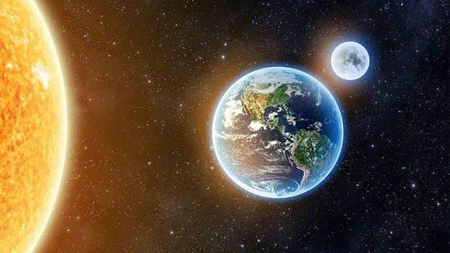
An unscientific approach
Modern Science
differences
The Moon
Earth's External Life Support System, the Generator of programs for the biosphere
Piece of a meteorite captured by Earth
The Basis –
Systemic Knowledge
The basis – modern science based on horse power

Slide 21
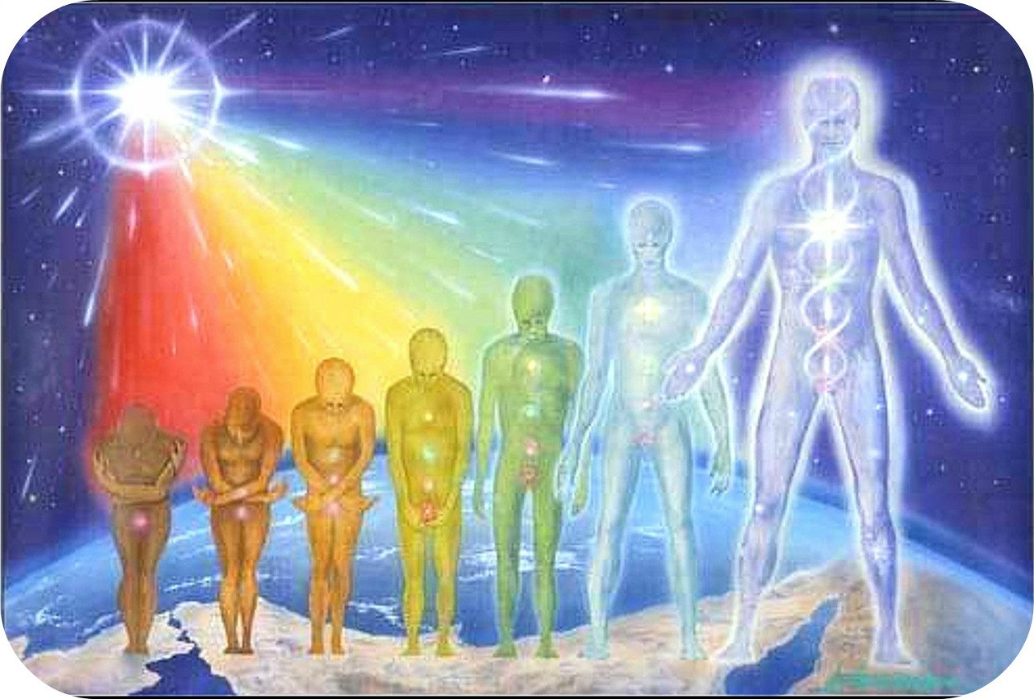
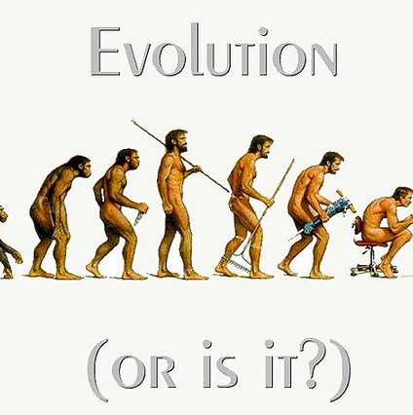
An unscientific approach
Modern Science
differences
Man
Man is formed by changing the octave of the sperm in the correct environment
Man evolved from an ape
The Basis –
Systemic Knowledge
The basis – modern science based on horse power

Slide 22
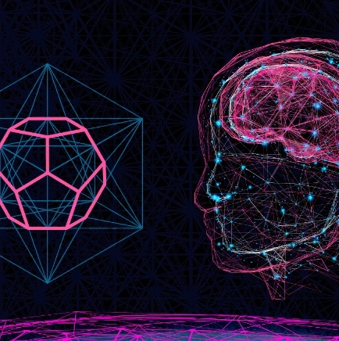
An unscientific approach
Modern Science
differences
The Brain
Man has a part of the operative Brain and a small part of long-term memory
Everything underneath the cranial bone
The Basis –
Systemic Knowledge
The basis – modern science based on horse power

Slide 23
Systemic Knowledge Websites
https://shkrudnev.com/
https://rnto.info/
https://rnto369.ru/
http://www.salvatorem.r/
https://prirodagizni.info/
https://yuratornado3.wixsite.com/cbornik
https://www.youtube.com/@user-nj4ht5cq9o
https://dzen.ru/id/62677e3dd4f4a907cc022039
https://rutube.ru/channel/4850589/
https://www.youtube.com/@9MIDGARD
https://www.svetl.one/
https://svetlworld.com/
https://www.lifegenerator.org/
https://www.nk369earth.com/
https://naujos-zinios.lt/
https://svetlmonde.com/
https://svetldream.com/
https://svetl.de/
Author Algis Skrinskis

